Slide 1



Slide 2

T H E A R T O F E X C L U S I V E A N D L I M I T L E S S T R A V E L I N G

Slide 3

Born at the crossroads of wanderlust and world‑class entertainment. We design seamless journeys to the globe’s most electrifying destinations. Our white‑glove concierge unlocks private villas, tailored transport, and coveted VIP access, transforming simple travel into an all‑access experience.
From doorstep to encore, we orchestrate every detail so you can savor the luxury, exclusivity, and memories that outlast for a lifetime.

Slide 4

W H I T E G L O V E C O N C I E R G E
Our bespoke concierge service is designed to elevate every moment of your journey. From securing private villas and luxury accommodations, arranging personalized ground transportation and getting you into the most exciting events, we ensure your experience is seamless from start to finish

Slide 5

J U S T A S K
Y O U G O T E V E R Y T H I N G Y O U N E E D .
A N D O U R C O N C I E R G E T E A M W I L L M A K E S U R E
Villas & Apartments
Luxury Vehicles
Boats & Yatchs
Ground Transportation
VIP Event Access
Night Club Access

Slide 6
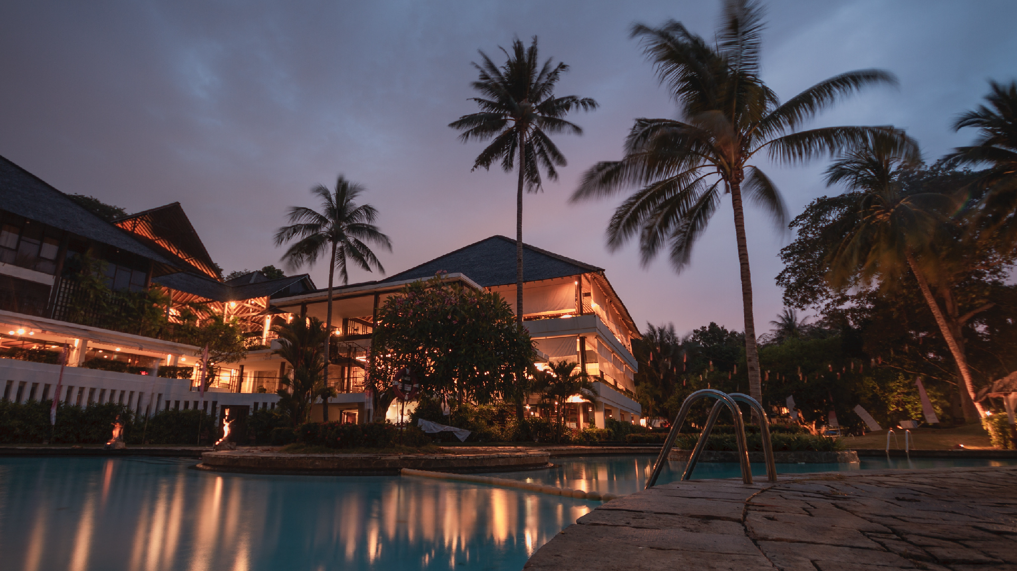

Slide 7

T H E S E A R E T H A T
G O A C C E S S
S O M E O F T H E H I G H P R O F I L E E V E N T S I N T H E W O R L D
W I L L H E L P Y O U S C O R E
Zamna
edc mexico
World cup 2026
Mexico F1 championship
Day zero
Vive latino

Slide 8
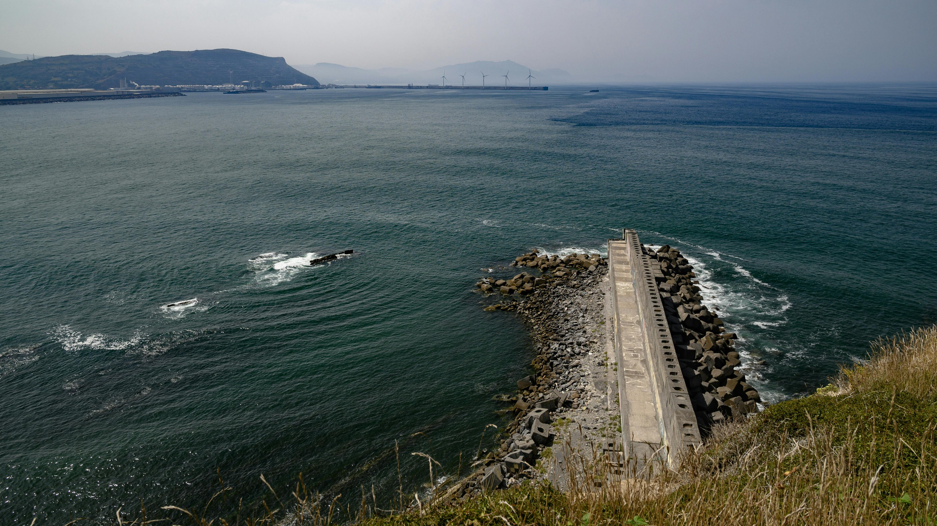

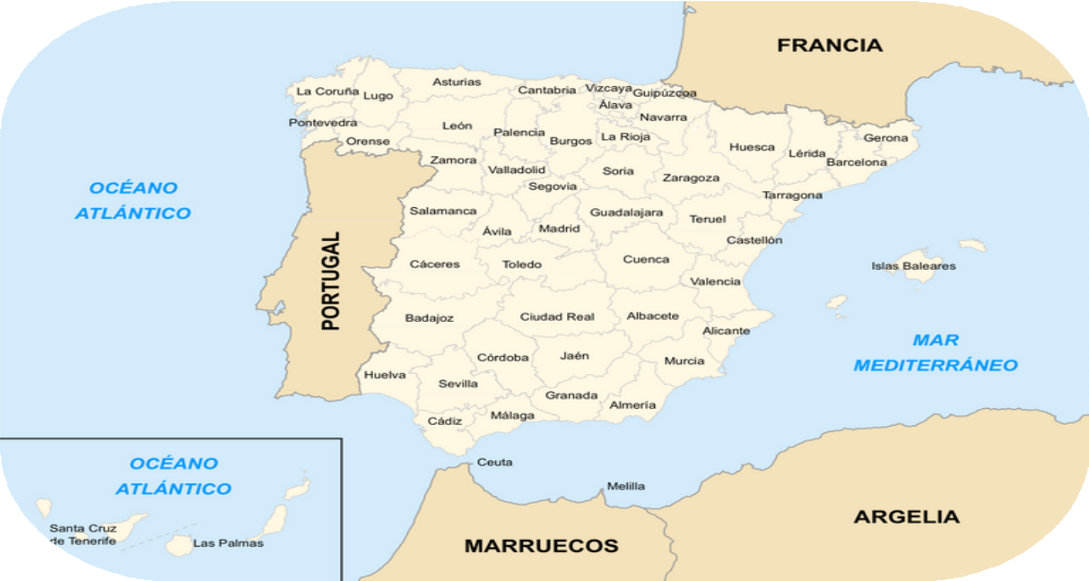
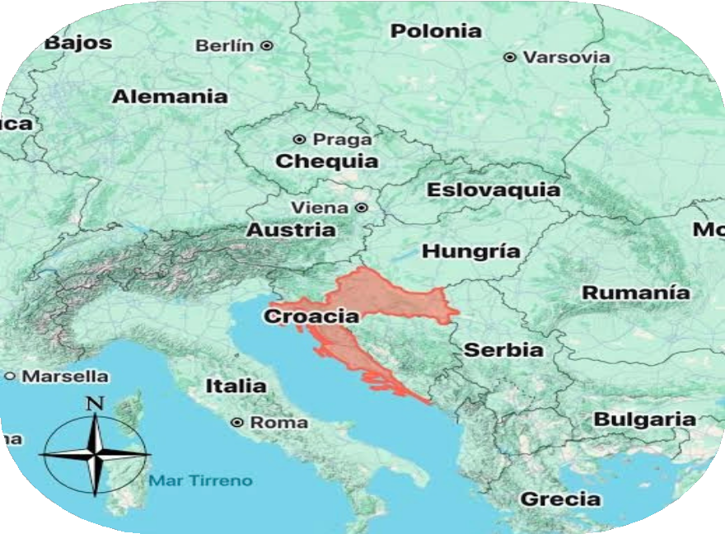
T H E R E P R I D E B E S T
A R E N O L I M I T S T O W H A T
E A C H
W E C A N D O , B U T
T O C R A F T T H E
W E T A K E
I N T R U L Y K N O W I N G
D E S T I N A T I O N
E X P E R I E N C E S F O R Y O U .

Slide 9







W E M A K E S U R E Y O U F I N D A W A Y T O G O
Ecommerce Payments
Multi Currency Deposits
Special Offers

Slide 10

1 0 0 %
P E R S O N A L I Z E D
S E R V I C E
Your time matters to us. Every journey we create is tailor-made for
you — shaped by who you are and what you seek. We take the
time to understand your desires, because for us, every trip is a memory in the making, and every traveler is truly one of a kind.
G E T A Q U O T E
F R O M
U S A N D S T A R T
P L A N N I N G J O U R N E Y .
Y O U R
N E X T
+52 33 2630 8755
hello@goaccess.live
@goaccess.live
www.goaccess.live

Slide 11

WI T H LO VE
- G O A C C ESS

